Slide 1
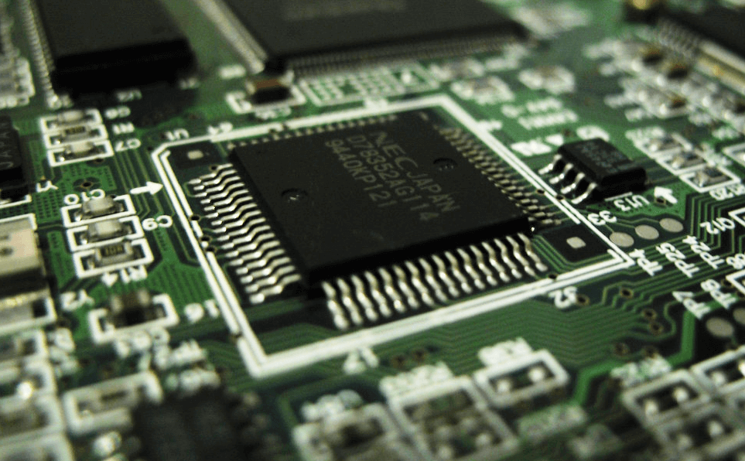
8085 Microprocessor
Dr. Manju Khurana
Assistant Professor, CSED
TIET, Patiala
manju.khurana@thapar.edu

Slide 2
Timers
Introduction to Microprocessor Based Systems Design
Real time applications - traffic lights, digital signals, process control.
2

Slide 3
Time delay using NOP Instruction
Introduction to Microprocessor Based Systems Design
NOP instruction does nothing but takes 4T states of processor time to execute. So by executing NOP instruction in between two instructions we can get delay of 4 T-State.
3

Slide 4
Time delay using counters
Introduction to Microprocessor Based Systems Design
Counting can create time delays. Since the execution time of the instructions used in a counting routine are known, the initial value of the counter, required to get specific time delay can be determined.
Using 8-bit counter:
 | No. of T-states
MVI C, count | 7
Back: DCR C | 4
JNZ Back | 7/10
Total T-states required to execute the given program:
= 7 + (count-1) × (4+10) + (4+7)
Let count = 5
No. of T-state = 7 + (5-1)×14 + 11
= 7 + 56 + 11 = 74
Assuming Operating frequency of 8085A is 2 MHz.
Time required for 1 T-state =
Total time required to execute the given program =
Maximum delay with 8-bit count is:
Let count = FF H = (255)₁₀
No. of T-state = (7 + (255-1)×14 + 11) × 0.5
= 1787 µsec
4

Slide 5
Time delay using counters contd.
Introduction to Microprocessor Based Systems Design
Using 16-bit counter:
Total T-states required to execute the given program:
= 10 + (count-1) × 24 + 21
Let count = 03FF H = (1023)₁₀
No. of T-state = 10 + (1022)×24 + 21
= 24559
Assuming Operating frequency of 8085A is 2 MHz.
Time required for 1 T-state =
Total time required to execute the given program =
 | No. of T-states
LXI B, count | 10
Back: DCX B | 6
MOV A, C | 4
ORA B | 4
JNZ Back | 7/10
Maximum delay with 16-bit count is:
Let count = FFFF H = (65535)₁₀
No. of T-state = (10 + (65535-1)×24 + 21) × 0.5
= 786423.5 µsec = 0.786425 sec
5

Slide 6
Time delay using Nested loops
Introduction to Microprocessor Based Systems Design
In this, there are more than one loops. The innermost loop is same as explained above. The outer loop sets the multiplying count to the delays provided by the innermost loops.
 | No. of T-states
MVI B, Multiplier count | 7
Start: MVI C, Delay count | 7
Back: DCR C | 4
JNZ Back | 7/10
DCR B | 4
JNZ Start | 7/10
T-states required for execution of inner loop:
T_{inner} = 7 + (Delay count-1) × (4+10) + (4+7)
T-states required for execution of the given program:
= 7 + (Multiplier count -1)× (T_{inner}+14) + 11
For Delay count = 65 H = (101)₁₀ and
Multiplier count = 51 H = (81)₁₀
T_{inner} = 7 + (101 – 1) )× 14 + 11 = 1418
Total time required to execute the given program =
(Assuming Operating frequency of 8085A is 2 MHz )
= 7 + ((81 – 1) × (1418 +14) + 11) × 0.5 µsec
= 57.7235 msec
6

Slide 7
Introduction to Microprocessor Based Systems Design
7

Slide 8
Introduction to Microprocessor Based Systems Design
8

Slide 9


